Slide 1

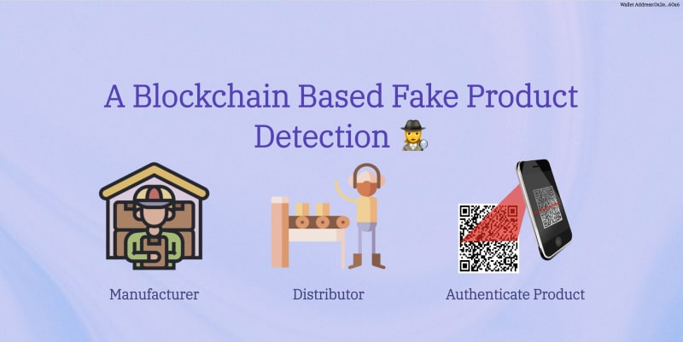
DEPARTMENT OF INFORMATION SCIENCE & ENGINEERING
BLOCKCHAIN ARCHITECTURE DESIGN AND USE CASE (18IS7F2)
7th Semester BE
Fake Product Identification using BlockChain
Evaluation- Phase-1
Academic Year – 2023-24
Carried Out By:
Shashi Ranjan(1RV20IS050)
Faculty Incharge :
Sharadadevi K ,Assistant Professor ,Dept. Of ISE,RVCE

Slide 2


In today's world, the rise of counterfeit products poses a real threat to both consumer safety and the credibility of brands. To tackle this challenge head-on, we've embraced an innovative solution that combines the power of blockchain and QR code technologies. This dynamic duo provides a foolproof method for authenticating products. By tapping into the decentralized and tamper-resistant nature of blockchain, each product is bestowed with a unique QR code, essentially a digital fingerprint rich with essential details. Consumers, armed with their mobile devices, can effortlessly scan these QR codes, instantly unraveling the authenticity of a product. This harmonious marriage of blockchain and QR code technologies not only shields consumers from counterfeits but also reinforces the trust and integrity of brands.

Slide 3
Topic Relevance
Blockchain Decentralized Transparency:Ensures supply chain transparency, simplifying traceability and verification processes to minimize the risk of counterfeit products.
Immutable Record Keeping:Guarantees product information integrity through immutability, preventing unauthorized changes and establishing a trustworthy record.
Smart Contracts for Automated Security:Utilizes smart contracts to automate real-time detection and response to discrepancies, enhancing security within the supply chain.
Trust Through Verification:Establishes trust by creating a decentralized database for authentic products, enabling consumers to easily verify details and ensuring confidence in purchased items.
Ethereum's Robust Framework:Ethereum smart contracts, decentralized applications, and ERC-20 tokens form a strong foundation for automating supply chain processes, ensuring transparency, and enabling traceability in combating fake products.

Slide 4
Objectives
The objectives are as follows:
Implement a blockchain-based system to counteract the production and distribution of counterfeit products.
Integrate QR codes for secure access to product details, ensuring client data protection and authenticity verification.
Leverage blockchain immutability to boost transparency, making consumers aware of authentic products and preventing the proliferation of fakes.

Slide 5



Technology used
Solidity
Javascript
CSS
HTML
Metamask

Slide 6
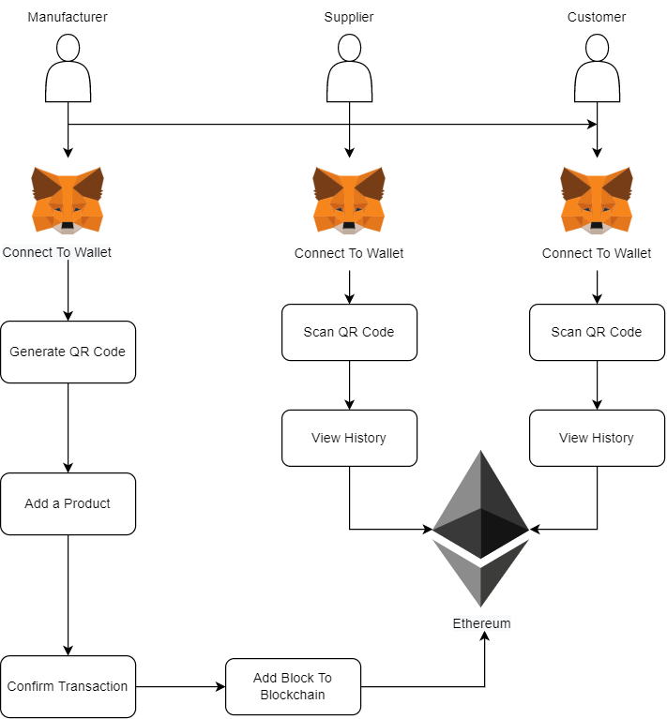
Architecture

Slide 7
References
1.https://www.itm-conferences.org/articles/itmconf/pdf/2022/04/itmconf_icacc2022_03015.pdf
2.https://ieeexplore.ieee.org/document/9766493
3.https://ijcrt.org/papers/IJCRT2207253.pdf
4.https://ijariie.com/AdminUploadPdf/Fake_Product_Detection_Using_Blockchain_Technology_ijariie14881.pdf
5.https://docs.soliditylang.org/en/v0.8.23/

Slide 8


